Slide 1
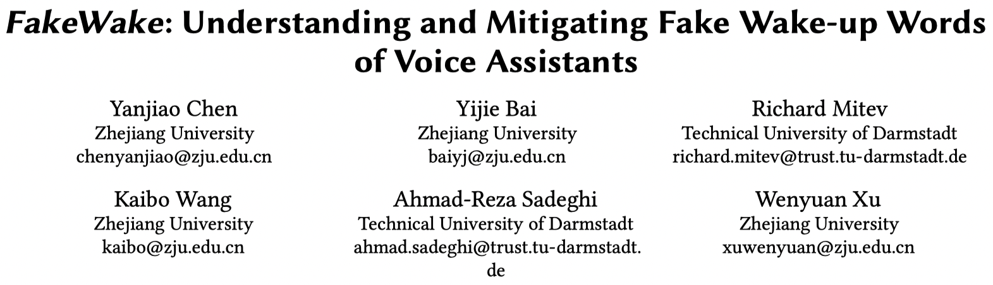
http://www.usslab.org/member/xuwenyuan.html

Slide 2
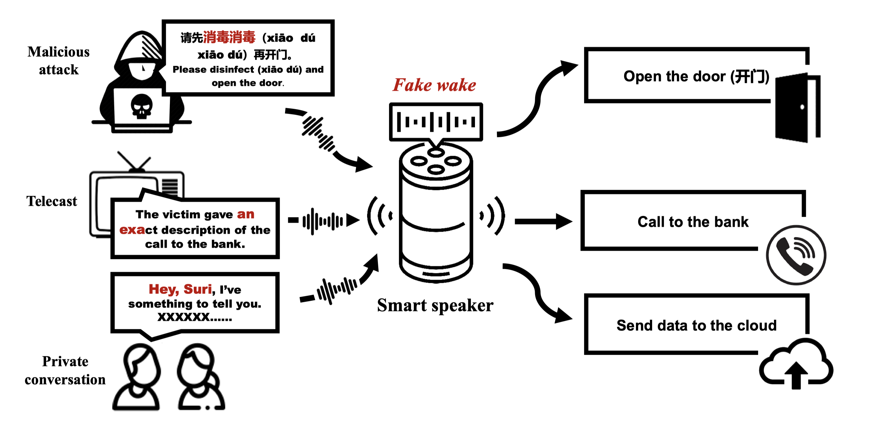
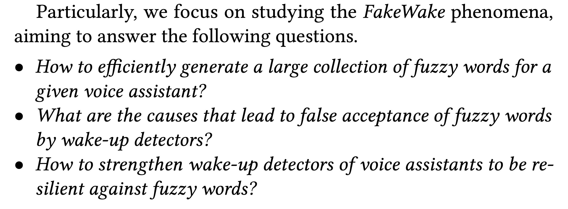
Black Box
No access to the training dataset

Slide 3
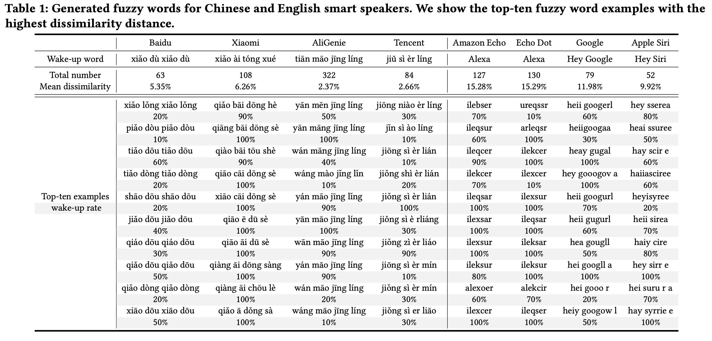

Slide 4
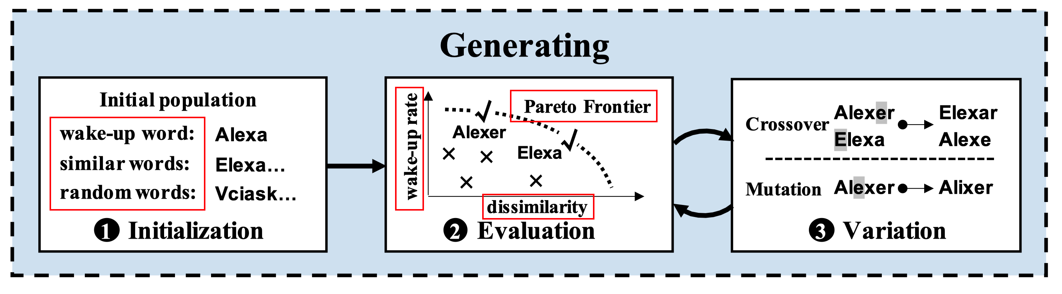

Slide 5
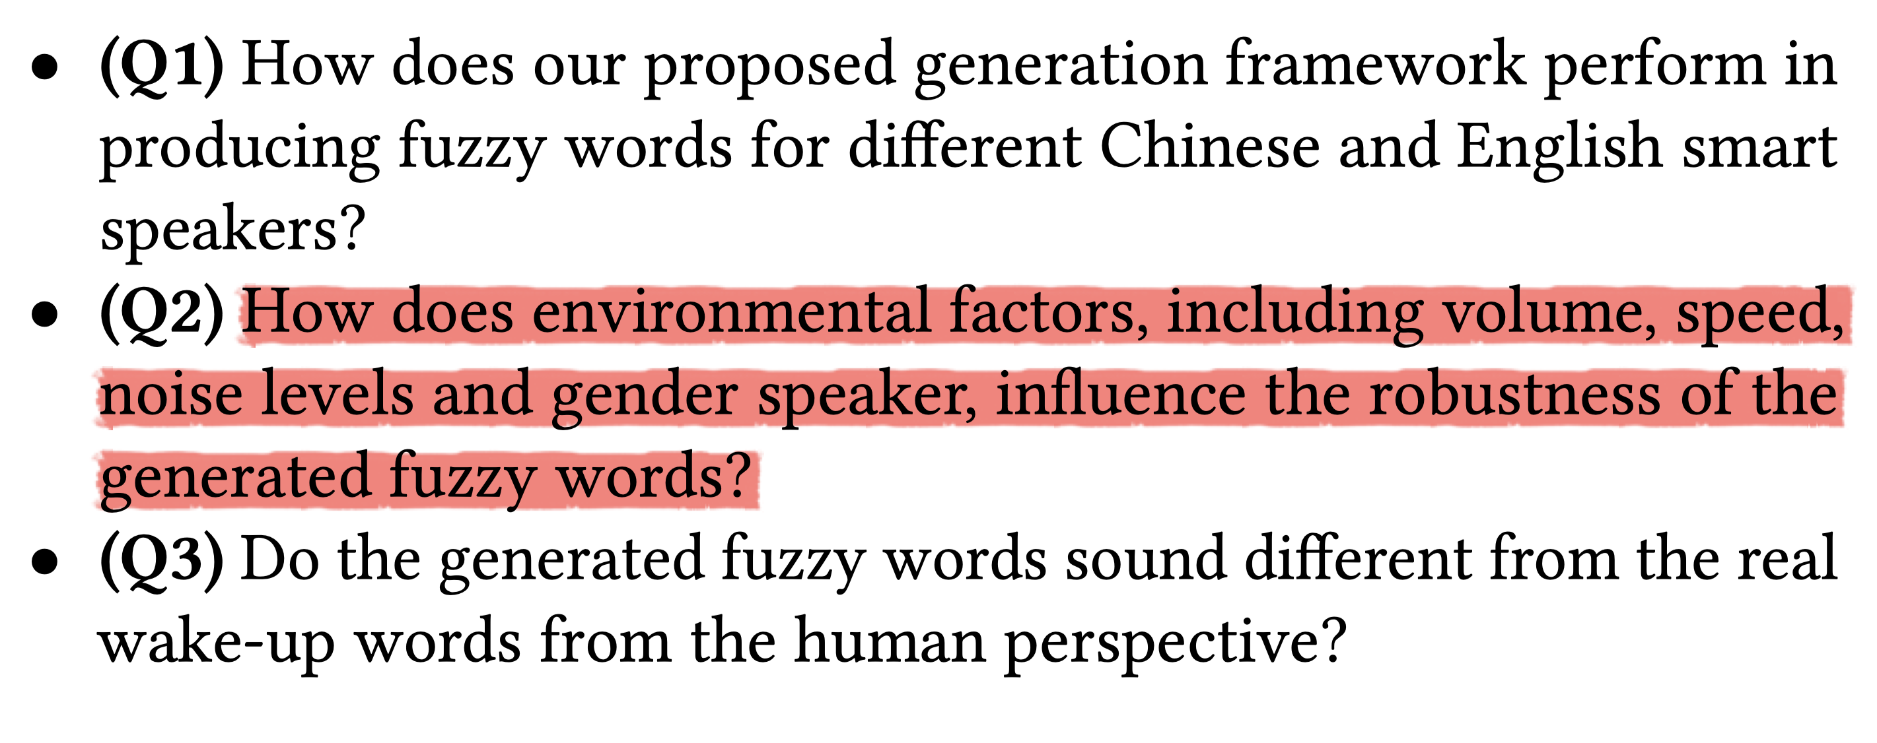

Slide 7
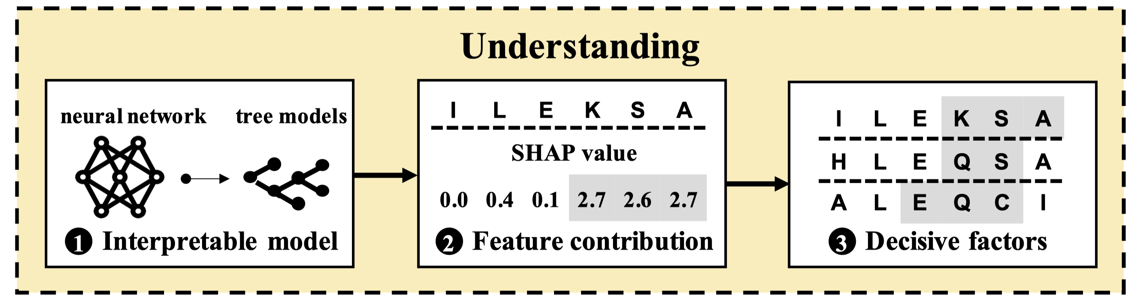
From local explanations to global understanding with explainable AI for trees

Slide 8
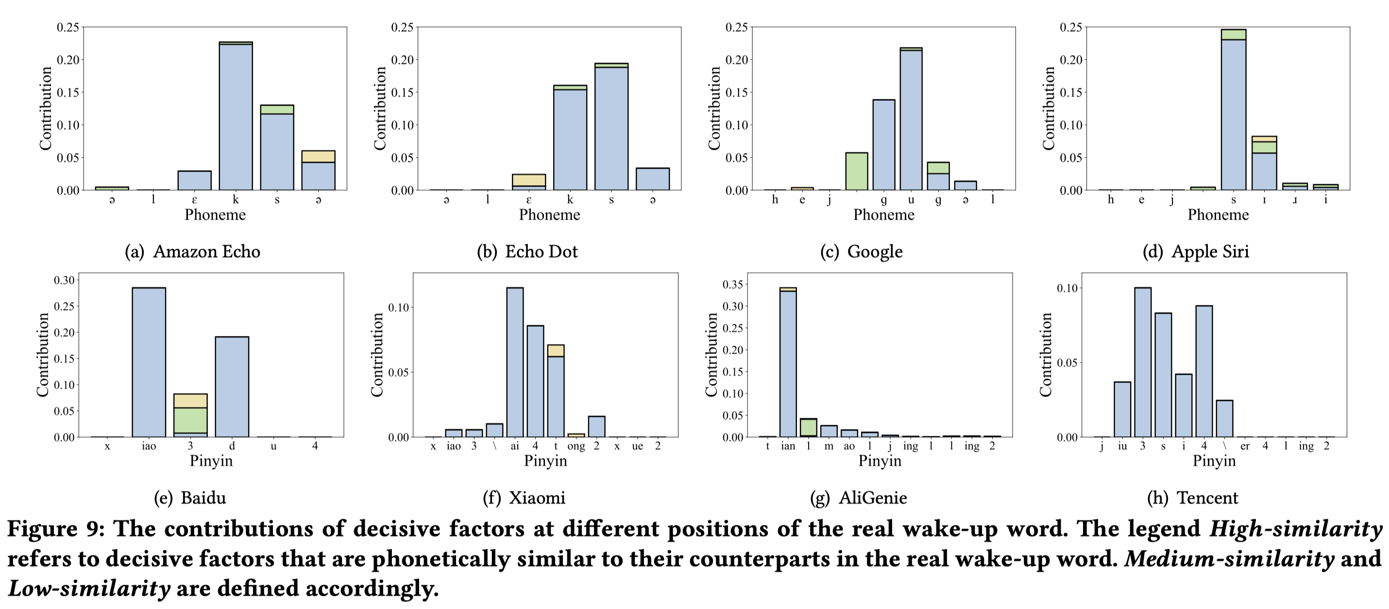

Slide 9
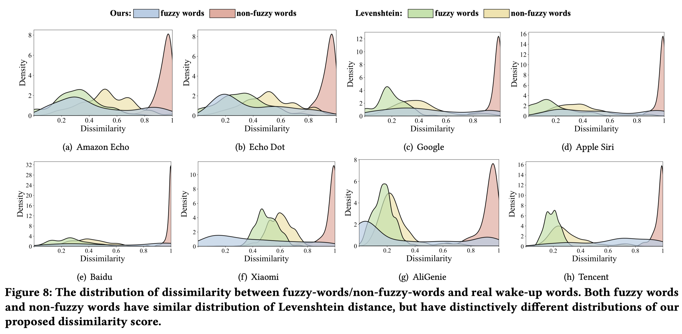

Slide 10
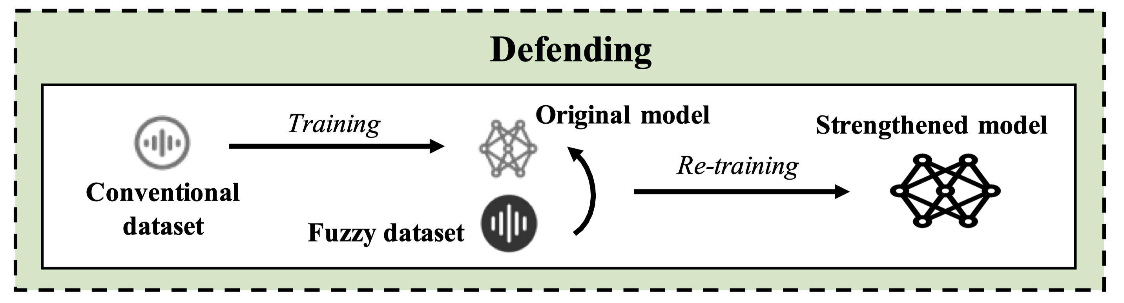

Slide 11
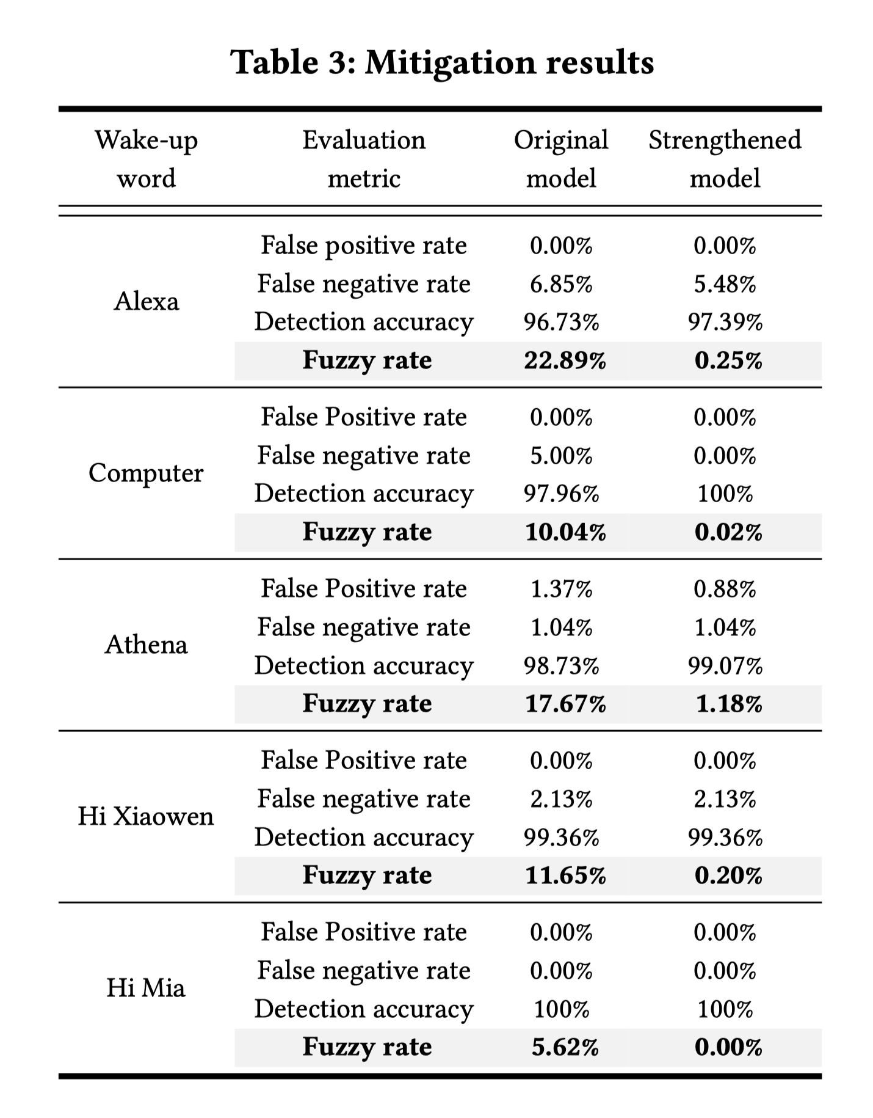

Slide 13
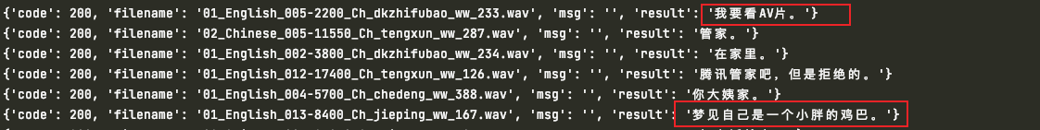
研究的问题非常有意思；
方法值得借鉴：用遗传算法来探测模型的脆弱性，然后用Shap Value来做可解释，最后提出了缓解方法；
文章写得非常好；

Slide 15
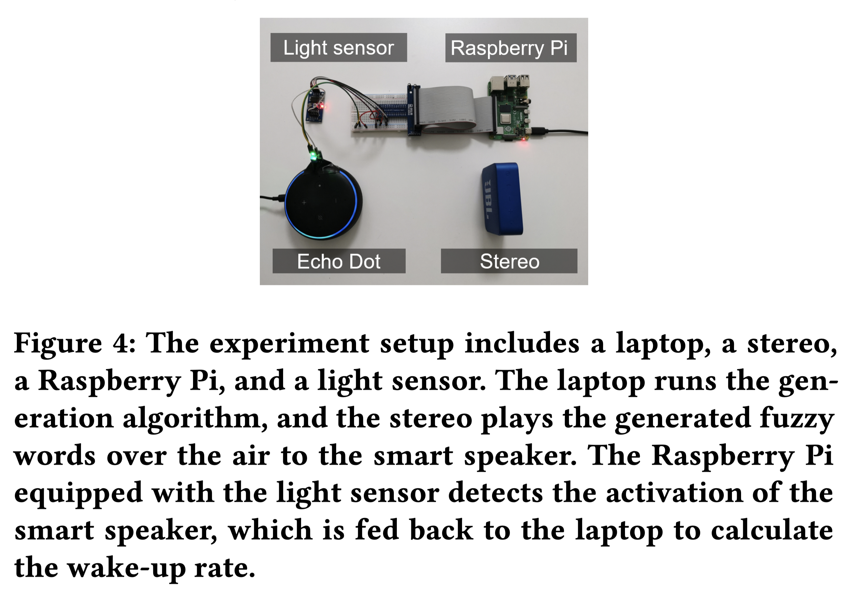

Slide 16
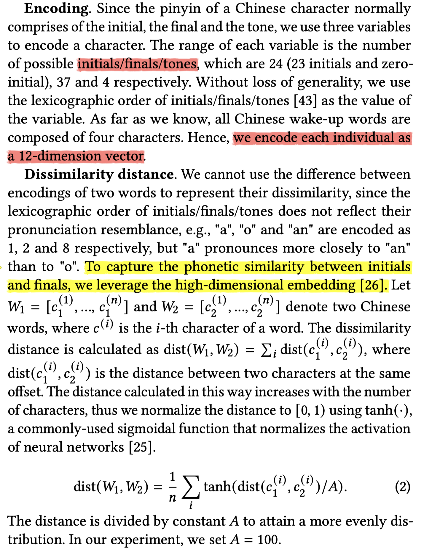
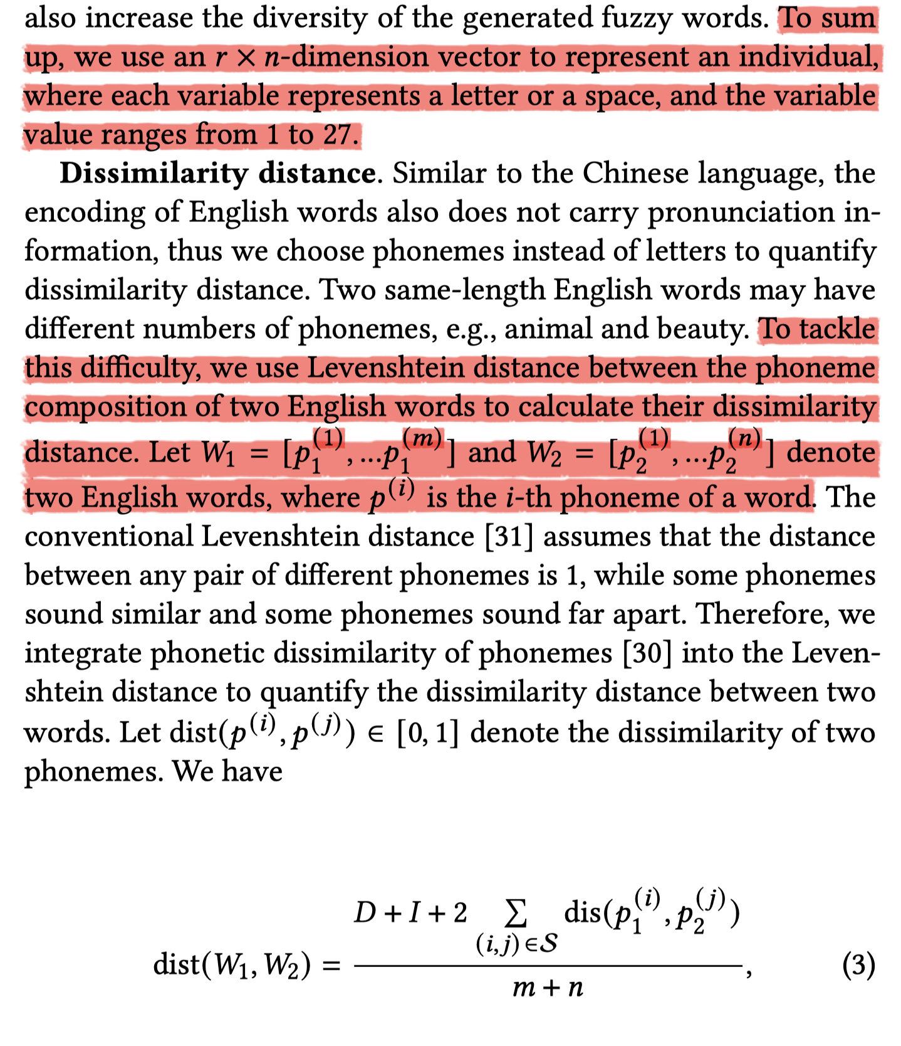
DIMSIM: An Accurate Chinese Phonetic Similarity Algorithm Based on Learned High Dimensional Encoding.

Slide 17
